Slide 1
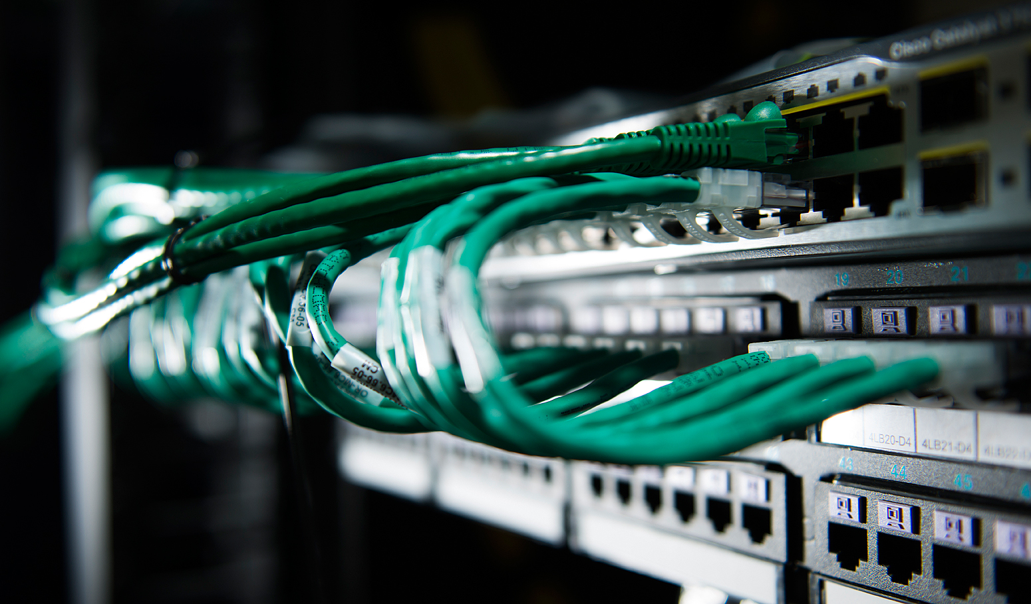
Communication Systems
George Zhuro, IO-21

Slide 2
What is “communication”?
The word itself is derived from the Latin verb “communicare”, which means “to share” or “to make common”.
Communication is the transfer of information from one place to another.
Simply: To connect source & destination.

Slide 3

Good communication should be:
As efficiently as possible.
With as much reliability as possible.
As securely as possible.

Slide 4
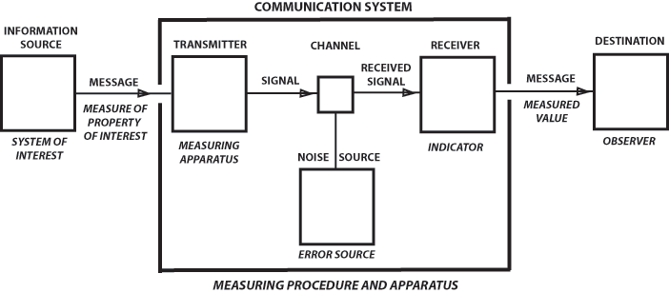
Parts of communication system

Slide 5
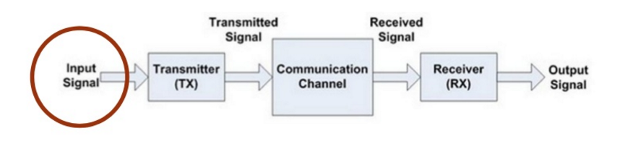
Information source

Slide 6
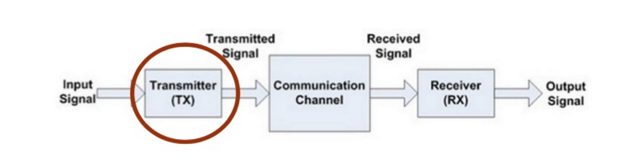
Transmitter

Slide 7
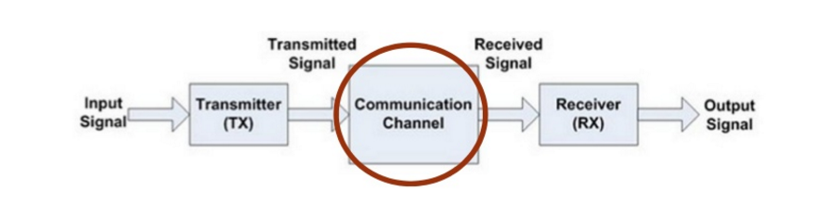
Communication channel

Slide 8
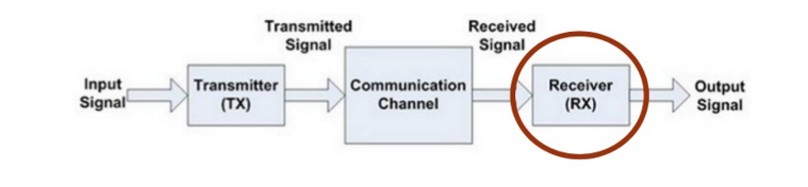
Receiver

Slide 9
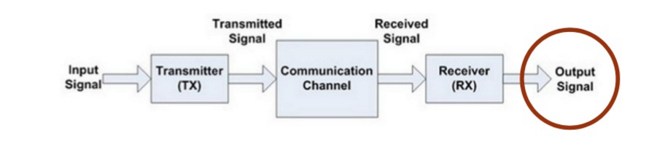
Output signal

Slide 10

What is a network?

Slide 11
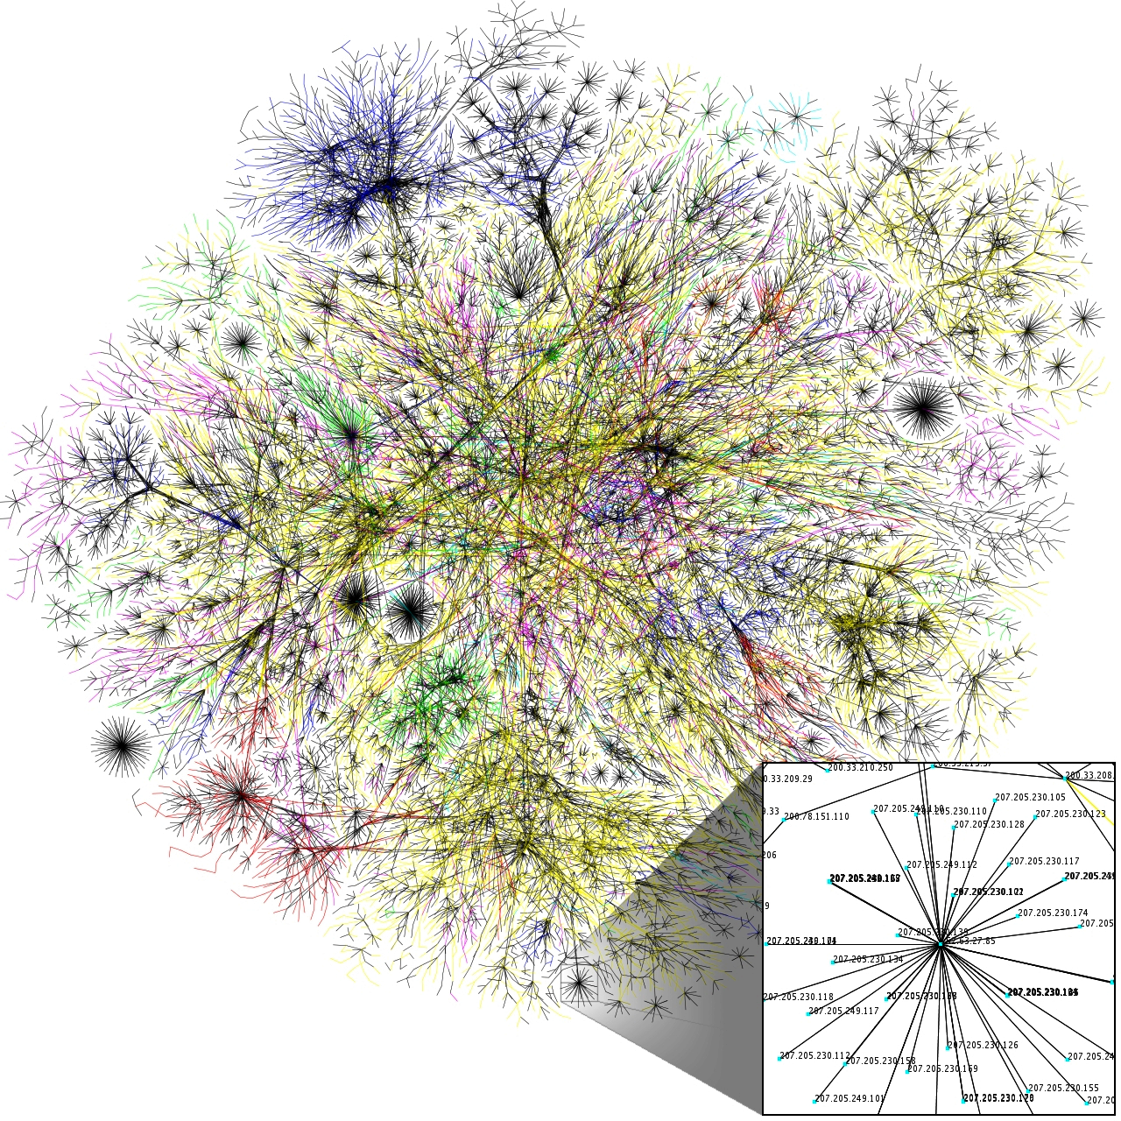

Slide 12


Slide 13
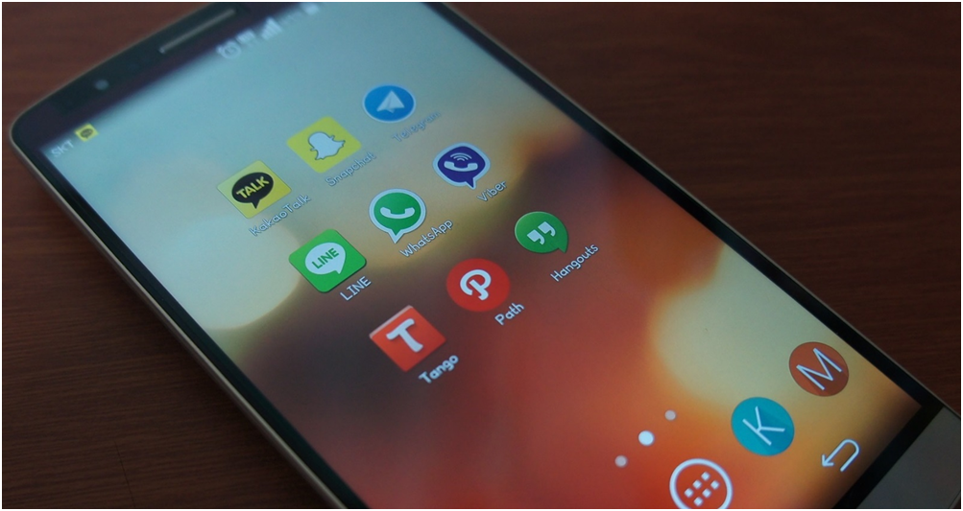

Slide 14
The end.

